Slide 1

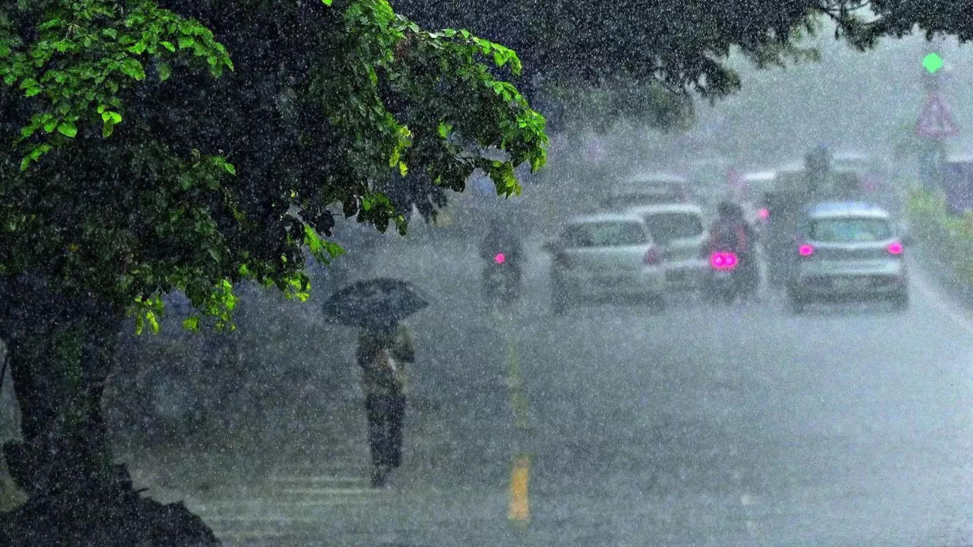


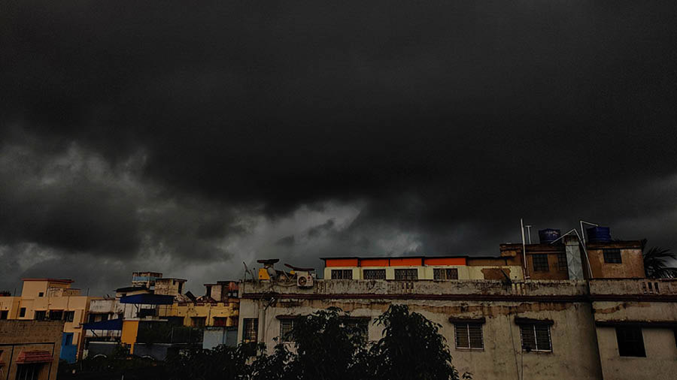
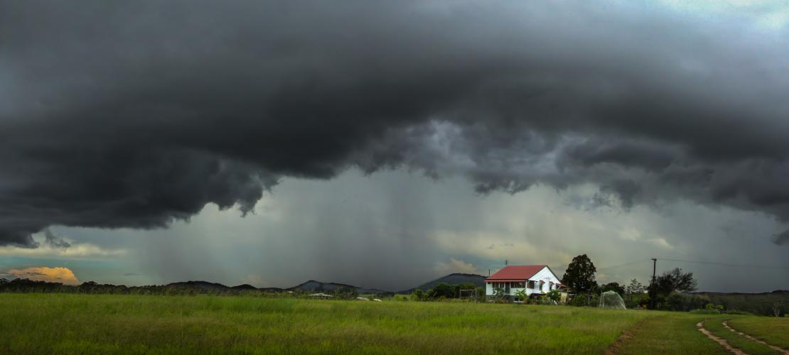
DISPLAY CURRENT WEATHER CONDITIONS
USING WEATHER API

Slide 2
A G E N D A
INTRODUTION
1
2
TECHNOLOGY USED
3
DATA SOURCE
4
WORKING PRINCIPLE
5
BENEFITS
6
CONCLUSION

Slide 3
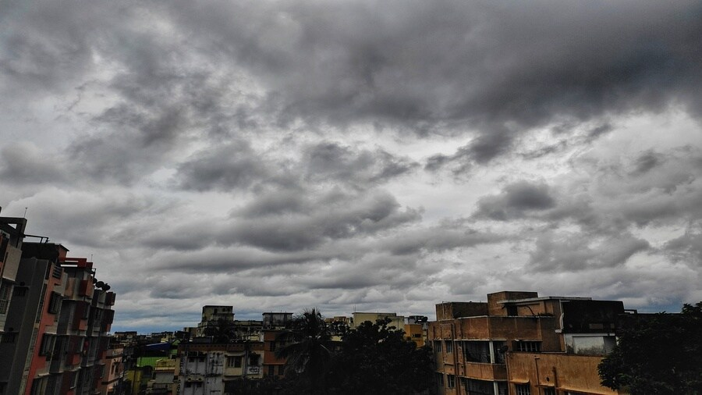
1
INTRODUTION
The Proposed System provides the weather of different cities around the Earth.
In this system the user can view Weather for which they search for.
The system can track Local and National Weather.
The Proposed system uses Openweathermap for searching the Weather.

Slide 4



2
TECHNOLOGY USED
Programming Languages
API: Openweathermap

Slide 5
3
DATA SOURCE
Our system uses Openweathermap to get the weather information.
Openweathermap, the World's largest API hub, is used by millions of developers to find, test, and connect to thousand of APIs.
The back-end of the application uses API from Openweathermap, which is an open source and enables anyone to download APIs for various purposes.
We are using "Weather by API-Ninjas" from RapidAPI Hub.

Slide 6
4
WORKING PRINCIPLE
The User is asked to enter the name of the city.
User then clicks on Search which further calls the Rapid API.
Weather conditions of place which include Temperature, Humidity, Wind Speed, Wind Degree, Cloud PCT are displayed.If user wishes to search weather for other cities he can re- enter the city name in search bar and press enter.
If user wishes to exit, he can simply close the application.
In this system don't need to setup weather station in each city on each country to get weather information. We can get those information incuding Temperature, Humidity etc. by using Weather API.

Slide 7
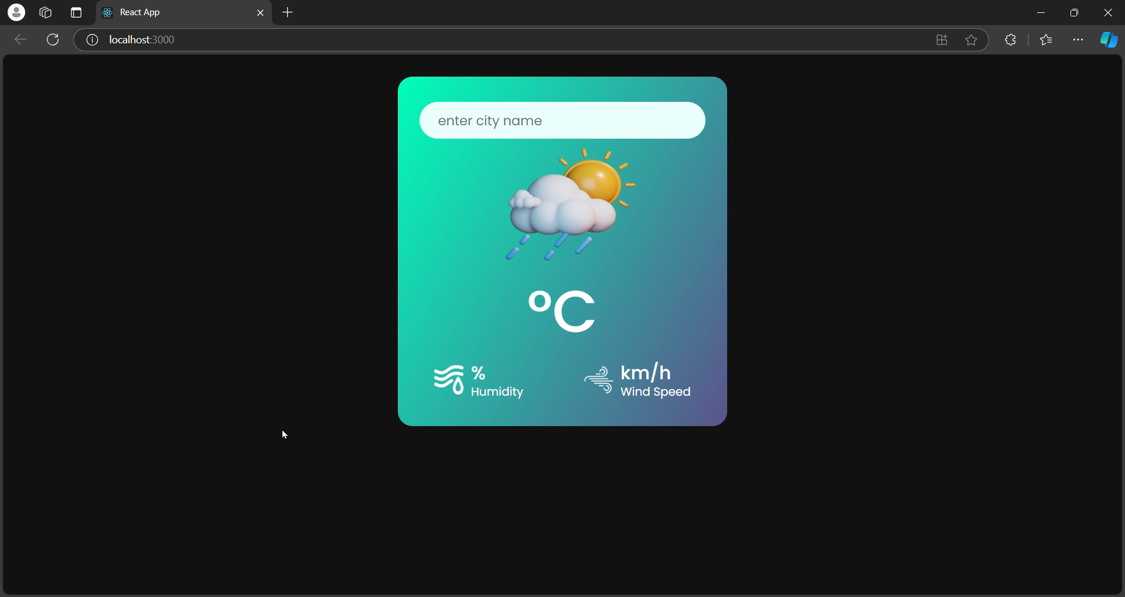
WORKING VIDEO

Slide 8
5
BENEFITS
The weather app enables you make better prepration for the day in relation to giving accurate daily weather.
We need Weather App to plan Jourmeys ahead. To plan meetings/commute timings.
A person travelling in a bus, train or flight may need to check the weather in his destination city.
The system provides you with details of the weather elements -Temperature, Wind speed, Humidity, Wind Degrees, Pecipitation , etc.

Slide 9
6
CONCLUSION
Reliable Weather API Importance
Using a dependable weather API like WeatherAPI.com ensures users receive accurate and timely weather data.
Wide Range of Features
Developers benefit from a diverse array of features provided by weather APIs, which enhance the functionality of their applications.
Ease of Integration
Weather APIs are designed for easy integration, allowing developers to implement them into applications with minimal effort.

Slide 12
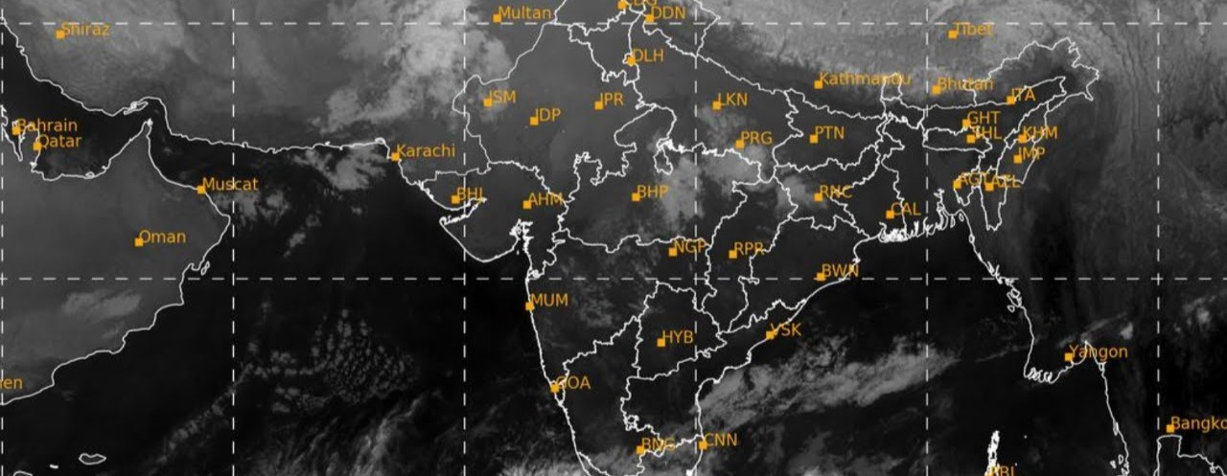

Slide 14

INTRODUTION TECHNOLOGY USED DATA SOURCE BENEFITS ARCHITECTURE DIAGRAM WORKING PRINCIPLE DEMO VIDEO DISPLAY CURRENT WEATHER CONDITIONS USING WEATHER API CONCLUSION
WORKING VIDEO

